Slide 1

Academic Session 2025-26
Even Semester Jan-Jun’26
Apex Institute of Technology
Department of Artificial Intelligence and Machine Learning
System Design (23CST-390)
Faculty: (Er.) Kamaljeet Kaur (E19147)
DISCOVER . LEARN . EMPOWER
Lecture
Introduction to System Design

Slide 2
Learning Objectives
Understand the fundamental concepts of system design and its importance in building
scalable applications.
Learn the principles of scalability, availability, and reliability in large systems.
Differentiate between Monolithic and Microservices architectures.
Explain key performance metrics such as latency and throughput.
Understand how caching improves system speed and reduces load on backend services.

Slide 3
Course Outcomes
On completion of this course, the students shall be able to:-
CO1 | Understand the fundamental system design principles, including scalability, high availability, and fault tolerance, while analyzing how these core principles influence architectural decisions in real-world distributed environments.
CO2 | Apply various distributed architectural patterns, key database models (SQL and NoSQL), and critical communication protocols to evaluate their specific applications and trade-offs in modern system designs.
CO3 | Apply advanced scaling techniques, such as caching, load balancing, database sharding, and replication, to design system components that effectively handle massive user traffic and data volumes.
CO4 | Analyze the trade-offs between different system architectures, data storage solutions, and consistency models (like the CAP theorem) to select and justify optimized configurations for performance, cost, and reliability goals.
CO5 | Create and document comprehensive, end-to-end system designs that are inherently scalable, distributed, and fault-tolerant, leveraging modern paradigms such as cloud computing and microservices architecture.

Slide 4
Unit-1 Syllabus
Unit-1 | System Design
Introduction to System Design | Introduction to System Design, Functional & Non-Functional Requirements, Scaling Challenges, Load Balancing, Caching Strategies, Replication, Sharding.
Databases in System Design | Databases in System Design – SQL vs NoSQL, CAP Theorem, Distributed Databases, Consistency Models, Eventual Consistency, Distributed Caching (Redis, Memcached), High Availability, Fault Tolerance, Microservices vs Monolithic Architecture.

Slide 5
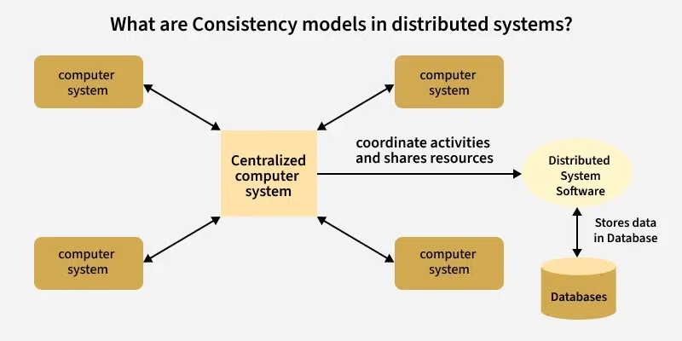
Consistency Models
Consistency model acts as a contractual agreement between a distributed data store and the processes that access it. It defines the rules for how and when updates made by one node become visible to others.

Slide 6
Consistency Spectrum
Strong Linearizability
System behaves as a single copy. Highest latency.
Sequential Ordering Preserved
Operations appear in a specific order, but not necessarily real-time.
Causal Cause & Effect
Related events are seen in order; unrelated events can be parallel.
Eventual Convergence
Replicas converge eventually. Lowest latency, high availability.

Slide 7
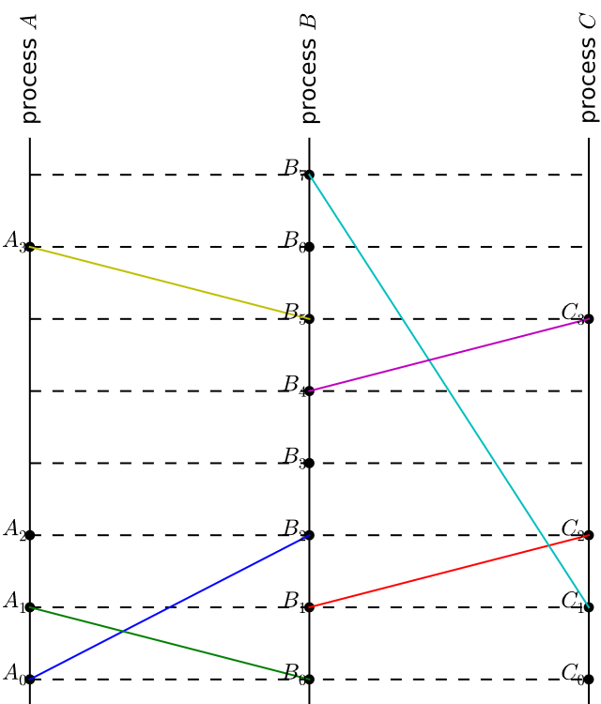
Linearizability
Linearizability (Strict Consistency) is the strongest guarantee. It requires that once a write completes, all subsequent reads (by wall-clock time) return that value.
It provides the illusion that the entire distributed system is just a single machine. While easiest for developers to reason about, it imposes significant latency penalties.

Slide 8
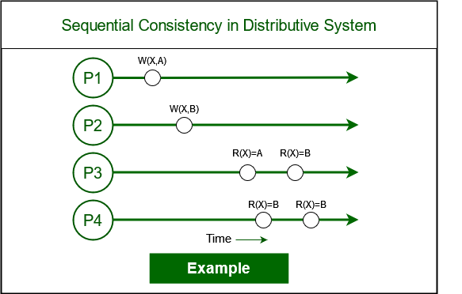
Sequential Consistency
Unlike Linearizability, Sequential Consistency does not require strict adherence to real-time (wall-clock) order.
It guarantees that:
The result of execution is the same as if all operations were executed in some sequential order.
Operations from a single processor appear in the order specified by its program.
This is useful for queues and FIFO buffers where order matters more than "exact time."

Slide 9
Summary of the Lecture
Scalability, Availability, and Reliability:
The lecture explained how systems must grow with user demand (scalability), stay accessible without downtime (availability), and function correctly even during failures (reliability).
Monolithic vs Microservices:
We learned the difference between a single, unified application (monolith) and a collection of small, independent services (microservices), including when each approach is useful.
Latency and Throughput:
These performance metrics were discussed to understand system efficiency—latency measures response time, while throughput measures how many requests a system can handle per second.
Caching:
The lecture highlighted caching as a method to store frequently accessed data for quick retrieval, helping to reduce load on servers and speed up system performance.

Slide 10
Next Lecture
Functional vs. Non-Functional Requirements
Scaling Challenges: Horizontal vs. Vertical Scaling
Load Balancing – Principles and Deployment Strategies
Load Balancing Algorithms (RR, Weighted RR, Least Connection)

Slide 11
Quiz/ FAQ’s
1. What is the main difference between vertical and horizontal scaling?
A. Vertical scaling adds more machines; horizontal scaling increases RAM
B. Vertical scaling increases resources of one machine; horizontal scaling adds more machines
C. Both increase CPU only
D. None of the above
Correct Answer: B
2. Which component helps distribute traffic among multiple servers?
A. Cache
B. Database
C. Load Balancer
D. API Gateway
Correct Answer: C
3. What is the purpose of caching in a system?
A. To store data permanently
B. To speed up data retrieval by storing frequently accessed data
C. To replace the database
D. To improve microservices communication
Correct Answer: B

Slide 12
References/ Articles/ Videos
Book Reference:
System Design Guide for Software Professionals- Kindle Edition by Dhirendra Sinha (Author), Tejas Chopra (Author) Format
Tutorial Link:
https://www.geeksforgeeks.org/system-design/system-design-tutorial/
Video Link:
https://www.youtube.com/results?search_query=Introduction+to+System+Design
https://x.com/ShradhaKhapra_

Slide 13

Class-Wise Feedback

Slide 14
Thank You
For queries Email: kamaljeet.e19147@cumail.in

